Slide 1

Data Retrieval using Subqueries
Syed

Slide 2
What is Subquery?
A subquery in MySQL is a query, which is nested into another SQL query and embedded with SELECT, INSERT, UPDATE or DELETE statement along with the various operators.
A subquery is known as the inner query, and the query that contains subquery is known as the outer query.

Slide 3
Order of Execution
The inner query executed first gives the result to the outer query, and then the main/outer query will be performed.
Sub queries must be closed within parenthesis.

Slide 4
The following are the rules to use subqueries:
Subqueries should always be in parentheses.
If the main query does not have multiple columns for subquery, then a subquery can have only one column in the SELECT command.
We can use various comparison operators with the subquery, such as >, <, =, IN, ANY, SOME, and ALL
We cannot use the ORDER BY clause in a subquery, although it can be used inside the main query.

Slide 5
The following are the advantages of using subqueries:
The subqueries make the queries in a structured form that allows us to isolate each part of a statement.
The subqueries provide alternative ways to query the data from the table; otherwise, we need to use complex joins and unions.
The subqueries are more readable than complex join or union statements.

Slide 6
MySQL Subquery Syntax
SELECT column_list (s) FROM table_name
WHERE column_name OPERATOR
(SELECT column_list (s) FROM table_name [WHERE])

Slide 7
MySQL Subquery Example
Use hr;
SELECT emp_name, city, income FROM employees WHERE emp_id IN (SELECT emp_id FROM employees);

Slide 8
MySQL Subquery with Comparison Operator
We can use the subquery before or after the comparison operators that return a single value.
The returned value can be the arithmetic expression or a column function.
After that, SQL compares the subquery results with the value on the other side of the comparison operator.

Slide 9
SELECT * FROM employees WHERE employee_id IN (SELECT employee_id FROM employees WHERE salary > 15000);
Example 2:
SELECT first_name, job_id, salary FROM employees WHERE salary = (SELECT MAX(salary) FROM employees);

Slide 10
MySQL Subquery with IN or NOT-IN Operator
If the subquery produces more than one value, we need to use the IN or NOT IN operator with the WHERE clause.
Example:
SELECT First_Name, job_id FROM employees WHERE job_id NOT IN ( SELECT job_id FROM jobs WHERE job_id='IT_PROG');

Slide 11
MySQL Subquery in the FROM Clause
If we use a subquery in the FROM clause, MySQL will return the output from a subquery is used as a temporary table.
We called this table as a derived table, inline views, or materialized subquery.

Slide 12
Example:
Write a query to select last 10 records from a table.
SELECT * FROM (
SELECT * FROM employees ORDER BY employee_id DESC LIMIT 10) sub
ORDER BY employee_id ASC;

Slide 13
Scalar subqueries
Scalar sub queries are useful when calculating aggregates from multiple unrelated tables.

Slide 14
SELECT department_id, AVG(SALARY) FROM EMPLOYEES GROUP BY department_id HAVING AVG(SALARY)>=ALL (SELECT AVG(SALARY) FROM EMPLOYEES GROUP BY department_id);

Slide 15
MySQL Correlated Subqueries
A correlated subquery in MySQL is a subquery that depends on the outer query.
It uses the data from the outer query or contains a reference to a parent query that also appears in the outer query.
MySQL evaluates it once from each row in the outer query.

Slide 16
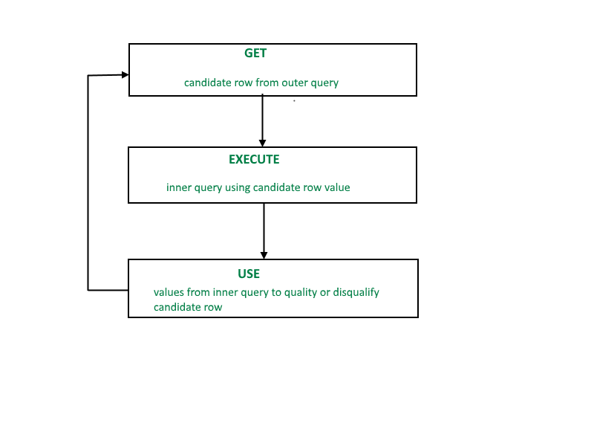
Correlated subqueries are used for row-by-row processing. Each subquery is executed once for every row of the outer query.

Slide 17
A correlated subquery is evaluated once for each row processed by the parent statement. The parent statement can be a SELECT, UPDATE, or DELETE statement.
Syntax:
SELECT column1, column2, .... FROM table1 outer WHERE column1 operator (SELECT column1, column2 FROM table2 WHERE expr1 = outer.expr2);

Slide 18
Correlated Sub Queries contd....
A correlated subquery is one way of reading every row in a table and comparing values in each row against related data.
It is used whenever a subquery must return a different result or set of results for each candidate row considered by the main query.
In other words, you can use a correlated subquery to answer a multipart question whose answer depends on the value in each row processed by the parent statement.

Slide 19
SELECT first_name, job_id, salary FROM employees emp WHERE salary> ( SELECT AVG(salary) FROM employees WHERE job_id = emp.job_id);
In the above query, we select first_name and job_id whose salary is higher than the average salary of all employees for each job_id..

Slide 20
MySQL Subqueries with EXISTS or NOT EXISTS
The EXISTS operator is a Boolean operator that returns either true or false result.
It is used with a subquery and checks the existence of data in a subquery.
If a subquery returns any record at all, this operator returns true. Otherwise, it will return false.

Slide 21
The NOT EXISTS operator used for negation that gives true value when the subquery does not return any row. Otherwise, it returns false.
Both EXISTS and NOT EXISTS used with correlated subqueries.

Slide 22
Write a query to find the name (first_name, last_name) of the employees who are not managers.
SELECT b.first_name,b.last_name FROM employees b WHERE NOT EXISTS (SELECT 'X' FROM employees a WHERE a.manager_id = b.employee_id);

Slide 23
Write a query to display the employee name( first name and last name ) and department for all employees for any existence of those employees whose salary is more than 3700.

Slide 24
SELECT first_name, last_name, department_id FROM employees WHERE EXISTS (SELECT * FROM employees WHERE salary > 3700.00);

Slide 25
MySQL Subqueries with ALL, ANY, and SOME
We can use a subquery which is followed by the keyword ALL, ANY, or SOME after a comparison operator.

Slide 26
The following are the syntax to use subqueries with ALL, ANY, or SOME:
operand comparison_operator ANY (subquery)
operand comparison_operator ALL (subquery)
operand comparison_operator SOME (subquery)

Slide 27
The ALL keyword compares values with the value returned by a subquery.
Therefore, it returns TRUE if the comparison is TRUE for ALL of the values returned by a subquery.

Slide 28
Write a query to find the name (first_name, last_name) and salary of the employees who earn a salary that is higher than the salary of all the Shipping Clerk (JOB_ID = 'SH_CLERK'). Sort the results of the salary of the lowest to highest.

Slide 29
SELECT first_name,last_name, job_id, salary FROM employees WHERE salary > ALL (SELECT salary FROM employees WHERE job_id = 'SH_CLERK') ORDER BY salary;

Slide 30
Write a query to display the employee number, name (first name and last name) and job title for all employees whose salary is smaller than any salary of those employees whose job title is MK_MAN.

Slide 31
SELECT employee_id, first_name, last_name, job_id FROM employees WHERE salary < ANY (SELECT salary FROM employees WHERE job_id = 'MK_MAN');

Slide 32
1. Write a query to display the name (first name and last name) for those employees who gets more salary than the employee whose ID is 163.
2. Write a query to display the name (first name and last name), salary, department id, job id for those employees who works in the same designation as the employee works whose id is 169.
3.Write a query to display the name (first name and last name), salary, department id for those employees who earn such amount of salary which is the smallest salary of any of the departments.
4.Write a query to display the employee id, employee name (first name and last name) for all employees who earn more than the average salary.
5.Write a query to display the employee name (first name and last name), employee id and salary of all employees who report to Steven.

Slide 33
Write a query to display the department number, name (first name and last name), job_id and department name for all employees in the Finance department.
Write a query to display all the information of an employee whose salary and reporting person id is 3000 and 121, respectively.
Display all the information of an employee whose id is any of the number 134, 159 and 183.
Write a query to display all the information of the employees whose salary is within the range 1000 and 3000.
Write a query to display all the information of the employees whose salary is within the range of smallest salary and 2500.

Slide 34
Write a query to display all the information of the employees who does not work in those departments where some employees works whose manager id within the range 100 and 200.
Write a query to display all the information for those employees whose id is any id who earn the second highest salary.
Write a query to display the employee number, name (first name and last name) and job title for all employees whose salary is more than any average salary of any department.
Write a query to display the employee id, name (first name and last name) and the job id column with a modified title SALESMAN for those employees whose job title is ST_MAN and DEVELOPER for whose job title is IT_PROG.
Write a subquery that returns a set of rows to find all departments that do actually have one or more employees assigned to them.

